Slide 1
Employee Data Analysis using Excel
STUDENT NAME: JOYS JESSY .S
REGISTER NO: 312215016
DEPARTMENT: commerce
COLLEGE : soka ikeda

Slide 2
PROJECT TITLE
Employee Performance Analysis using Excel

Slide 3


AGENDA
Problem Statement
Project Overview
End Users
Our Solution and Proposition
Dataset Description
Modelling Approach
Results and Discussion
Conclusion
3/21/2024 Annual Review

Slide 4

PROBLEM STATEMENT
What is the average salary by department?
2. Which department has the highest turnover rate?
3. What is the relationship between tenure and salary?
4. Are there any gender disparities in performance ratings?
5. Which job titles have the highest average performance ratings?
6. What is the average age of employees by department?
7. Are there any correlations between performance ratings and salary increases?

Slide 5

PROJECT OVERVIEW
TO ANALYSE AND EVALUATE EMPLOYEE PERFORMANCE IDENTIFY AREAS OF STRENGTH AND IMPROVEMENT AND PROVIDE INSIGHTS FOR INFORMED DECISION MAKING
.

Slide 6

WHO ARE THE END USERS?
ORGANISATION

Slide 7

OUR SOLUTION AND ITS VALUE PROPOSITION
1.Filtering : Filtering helps manage and analyze large datasets by focusing on relevant data subsets, thereby making data
handling more efficient and insightful. It subset of data from a larger dataset based on specific criteria or conditions. This
technique is widely used in data analysis, databases, and spreadsheets to focus on relevant information and exclude
irrelevant data.
2.IFS Formula: IFS formula is used for multiple conditional checks and returns value based on which condition
Is true . Unlike nested IF statement, IFS allows for a cleaner and more readable formula structure.the formula evaluates
each condition in order.
3.Pivot Tables: Pivot tables are tools used in spreadsheets to summarize and analyze large sets of data. They allow users
to quickly organize, group, and aggregate data, making it easier to extract meaningful insights and create dynamic
reports by rearranging and filtering information .

Slide 8
Dataset Description
We took the employee datas from kaggle website. We have 26 features totally.But, We used only 9 of the features.We entered the name of the employees in Alphabetical order. And we also enterd the employee type in Alphabetical order.We entered the performance level of the employee in Numerical value.We entered the gender of the employees as Male/Female.We entered the data of employee rating in Numerical value.We entered the Business unit in Alphabetical order.

Slide 9

THE "WOW" IN OUR SOLUTION
(i)=IFS(Z8>=5,”VERY HIGH”,Z8>=4,”HIGH”,Z8>=3,”MEDIUM,”TRUE,”LOW”
(ii)The above formula used to catagories the performance level of the employee is consider
as “WOW’ in my project
3/21/2024 Annual Review
9

Slide 10
MODELLING
DATA COLLECTIONS:
1.Dashboard
2.By formatting the dataset
FEATURES COLLECTIONS:
1.Data is collected from the dashboard
2.Formatting the data to find the employees performance level
DATA CLEANING:
1.Identifying the missing values
2.Filter outing the missing values
PERFORMANCE LEVEL:
1.Employees High Performance Level
2.Employees Low Performance Level
SUMMARY:
1.Categories the performance level of the employees
10

Slide 11
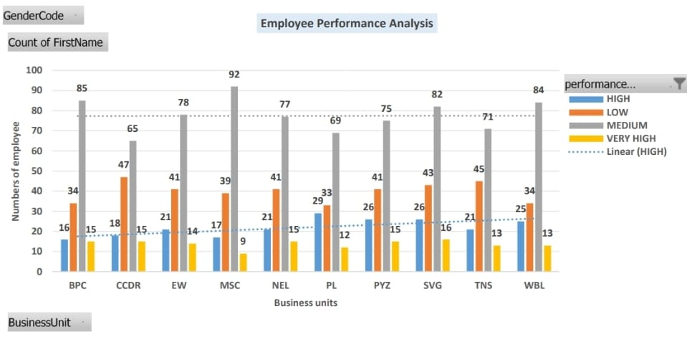
RESULTS
11

Slide 12
conclusion
1.In overall, majority employees got “Medium” level in their performance level.
2.In BPC, Employees performed in average level.
3.In CCDR & NEL, the employees got the medium level of performance level.
4.In EW, The employees got the medium and average level of performance level in
their business unit and their to know the performance of their performing level.
5. Based on the conditional formatting formula the excel sheet is formatting the solution
to find the performance level of the majority employees performance based on this

